Slide 1
How to Interpret Trajectory Surface Hopping Dynamics?
Tomislav Piteša Ruđer Bošković Institute, Bijenička cesta 54, Zagreb, Croatia
tpitesa@irb.hr
Computational Chemistry Day 2022
24 Sept 2022, IRB, Zagreb, Croatia

Slide 2
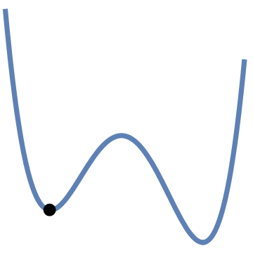
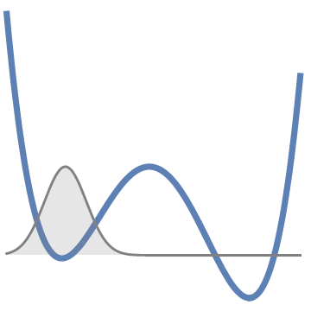
Born-Oppenheimer Molecular Dynamics
Classical Molecular Dynamics
Quantum Molecular Dynamics
$$M\dot{q}\left(t\right)=p\left(t\right)$$
+THERMOSTAT
$$\dot{p}(t)=−\vec{∇}V(q(t))$$
$$q\left(0\right),p(0)$$
$$q\left(t\right),p(t)$$
Potential energy surface
$$⇒{\hat{H}}_{el}ψ\left(r;q\right)=V(q)ψ\left(r;q\right)$$
$⇒$Semiempirical force field
$$iℏ\dot{χ}(q,t)=\left[\hat{T}+\hat{V}\right]χ(q,t)$$
$$χ\left(q,0\right)$$
$$χ\left(q,t\right)$$

Slide 3
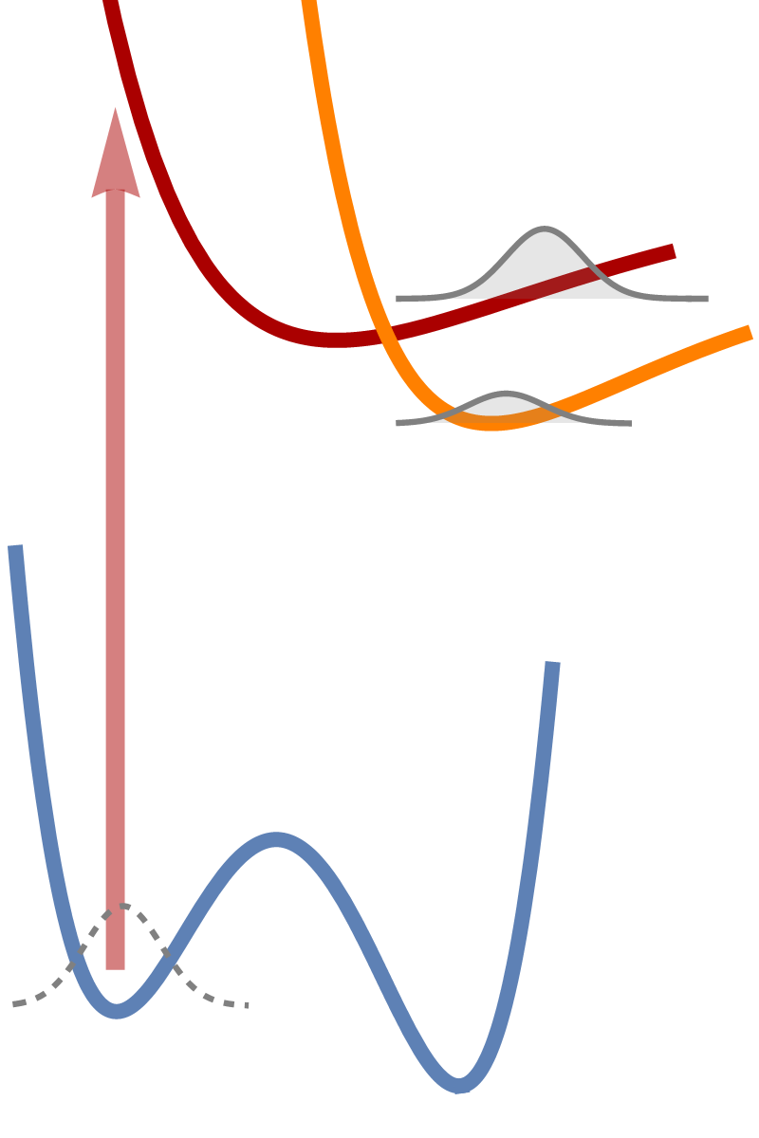
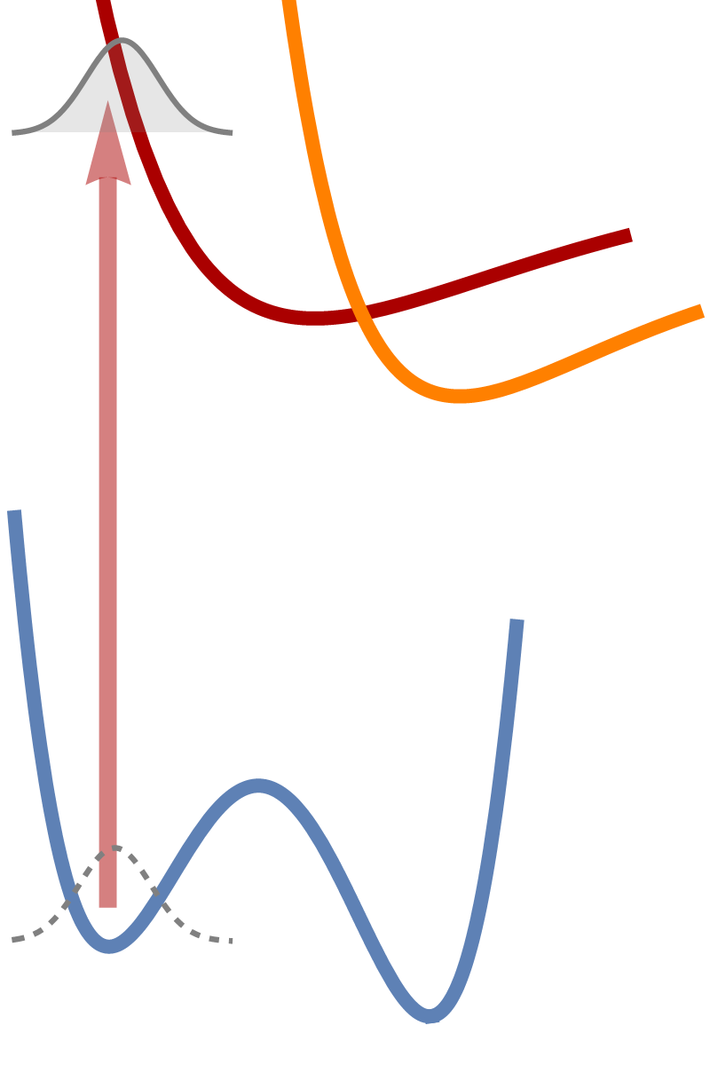
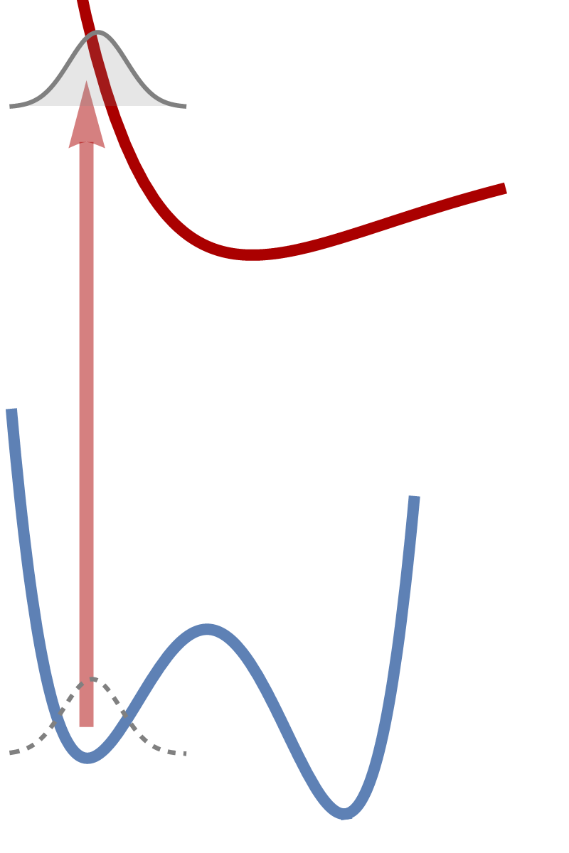
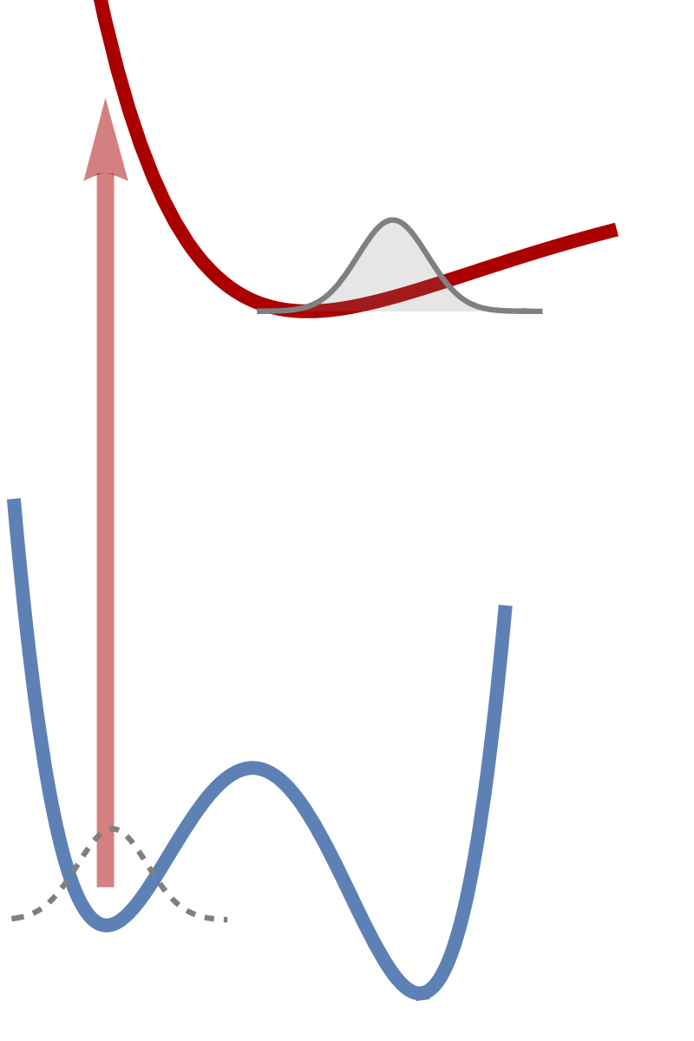
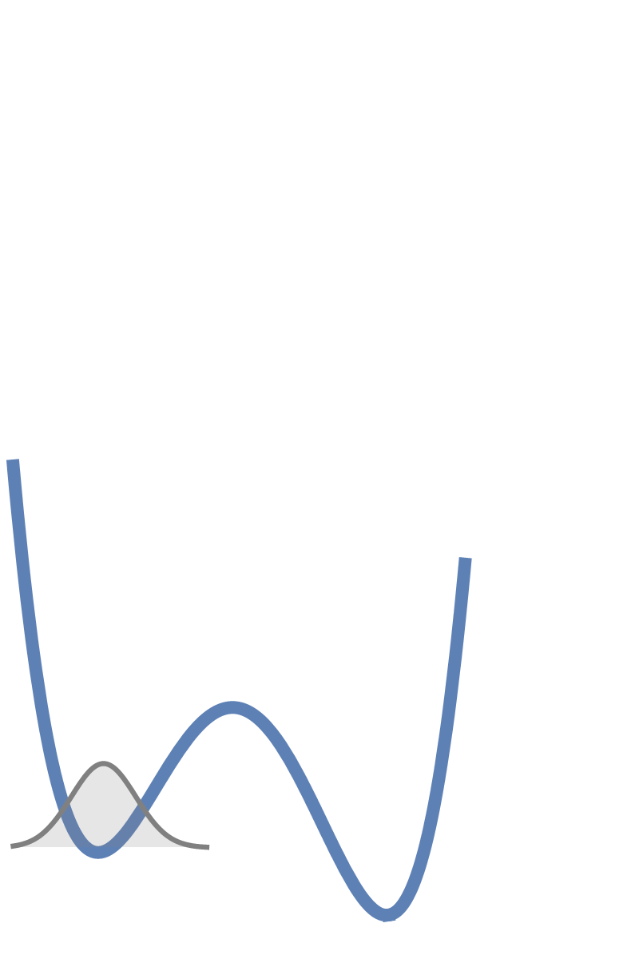
Photoinduced reactions
BO approximation
$$Π={\left|χ\right|}^{2}$$
$$Π={\left|χ\right|}^{2}$$

Slide 4
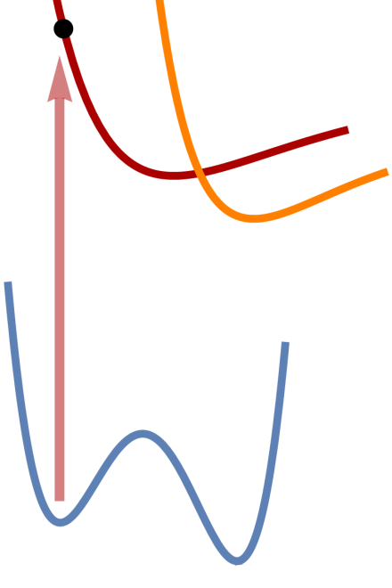
Nonadiabatic Molecular Dynamics
Quantum Nonadiabatic Molecular Dynamics
requires precomputed $V_{n}(q)$ and $f_{mn}(q)$
expensive
$f_{mn}(q)$ diverge on conical intersections
Classical Nonadiabatic Molecular Dynamics???
$$iℏ{\dot{χ}}_{n}=\left[\hat{T}+{\hat{V}}_{n}\right]χ_{n}−\sum_{m=1}^{N}{\underset{f_{mn}}{\underbrace{\left\langle ψ_{m} | ∇_{q} | ψ_{n}\right\rangle }}∙∇_{M^{−1}q}χ_{m}}, n=1,…,N$$

Slide 5
Trajectory Surface Hopping Dynamics
John Tully (1990): Fewest Switches Surface Hopping (FSSH) Dynamics:
$$M\dot{q}\left(t\right)=p\left(t\right)$$
$$\dot{p}(t)=−\vec{∇}V_{λ(t)}(q(t))$$
Classical nonadiabatic nuclear motion
$$q\left(0\right),p(0)$$
$$q\left(t\right),p(t)$$
$$P_{λ(t)→n}(t)=\frac{2Re\left[c_{n}^{∗}\left(t\right)c_{λ(t)}\left(t\right)d_{n,λ(t)}\left(t\right)\right]}{{\left|c_{λ(t)}\right|}^{2}}∆t$$
$$Ψ\left(t\right)=\sum_{n=1}^{N}{c_{n}\left(t\right)ψ_{n}\left(t\right)}$$
Qauntum nonadiabatic electronic motion
$$iℏ{\dot{c}}_{n}=V_{n}c_{n}+\sum_{m=1}^{N}{d_{mn}c_{m}}, n=1,…,N$$
Mixed Quantum-Classical Nonadiabatic Dynamics

Slide 6
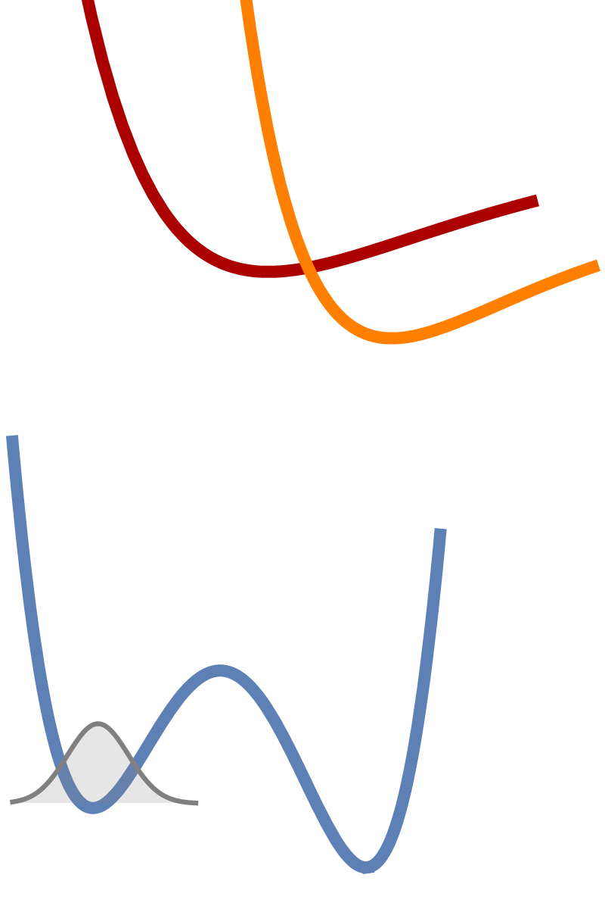
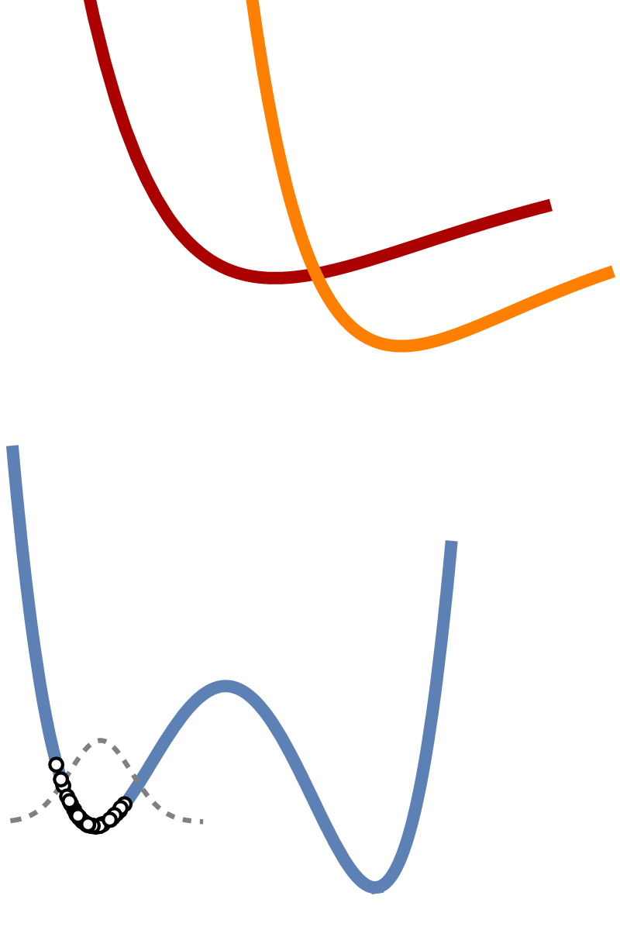
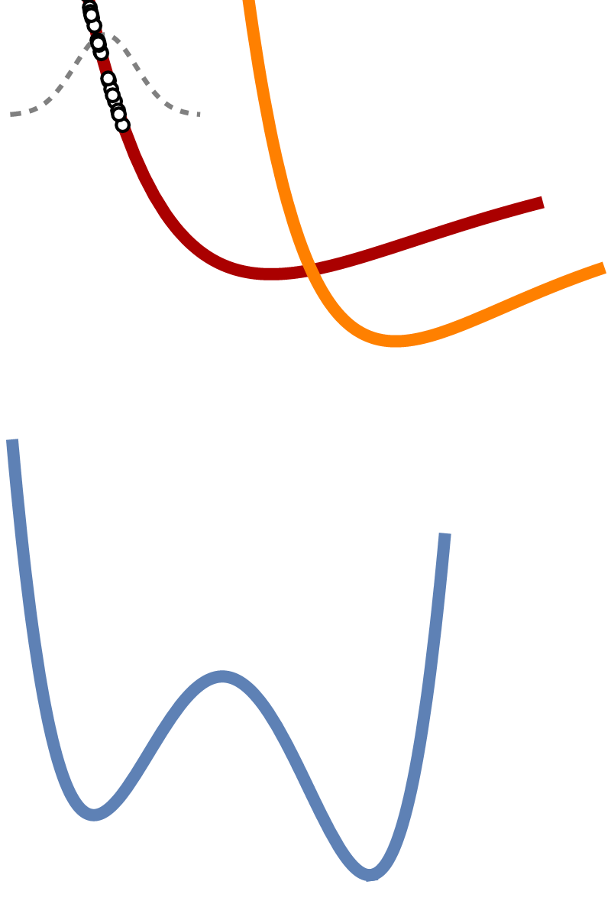
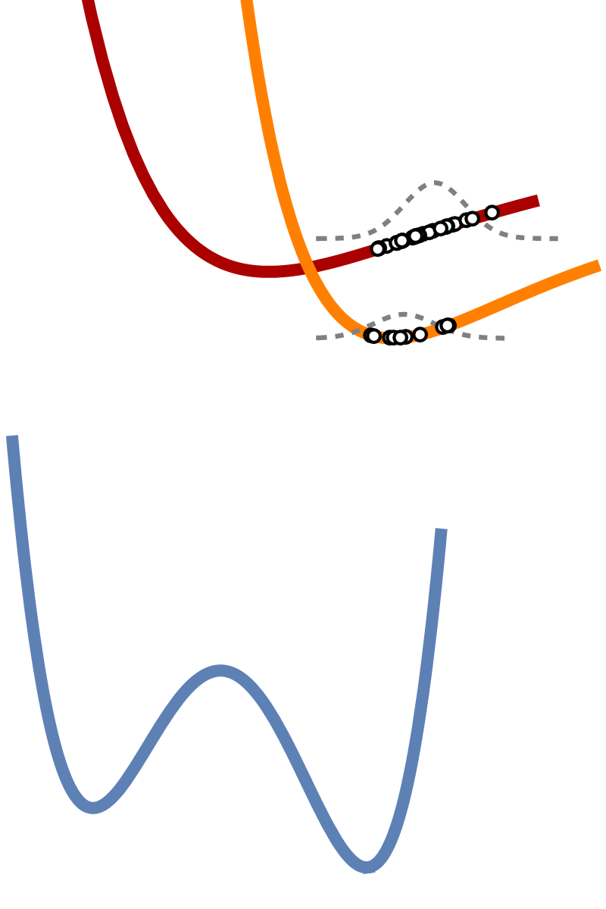
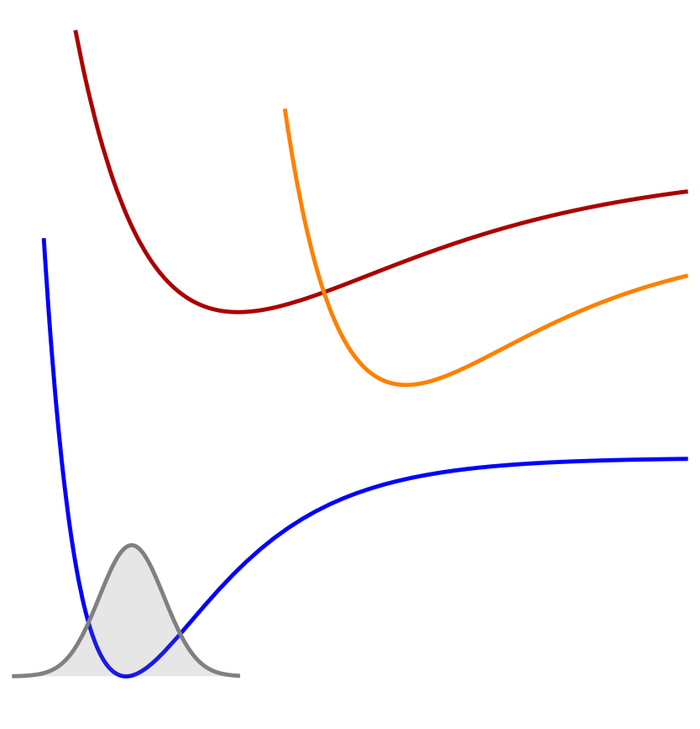
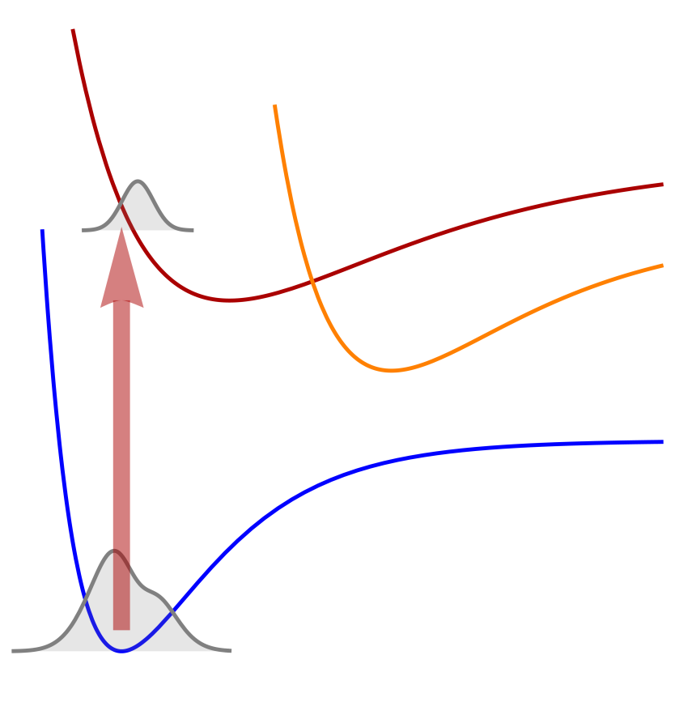
Trajectory Surface Hopping Dynamics
$$Π=\frac{80}{80}=100\%$$
$$Π=\frac{60}{80}=75\%$$
$$Π=\frac{0}{80}=0\%$$
$$Π=\frac{20}{80}=25\%$$

Slide 7
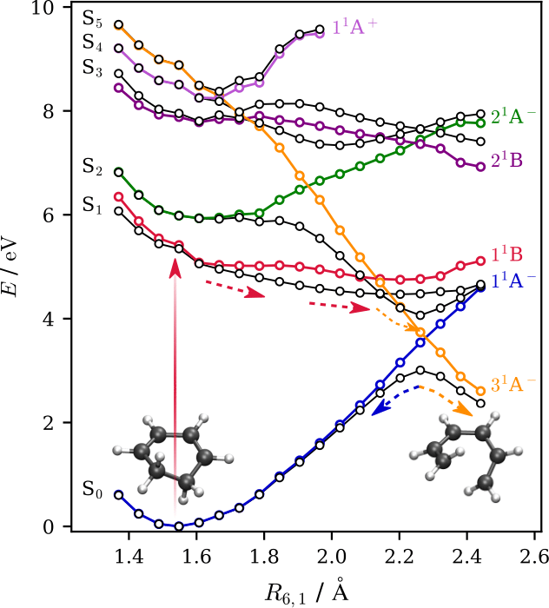
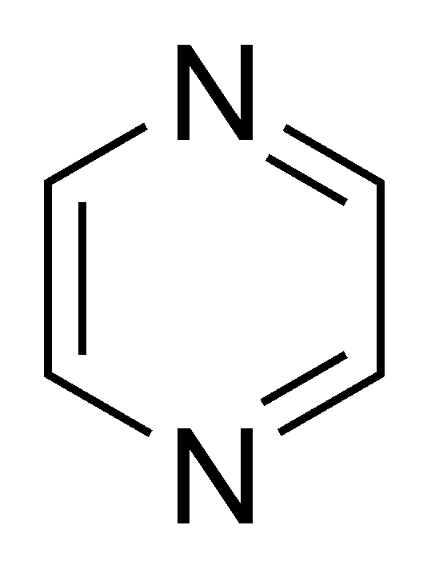
Pyrazine photodynamics
$$B_{2u}(ππ^{∗})$$
$$B_{3u}(nπ^{∗})$$
$$A_{u}(nπ^{∗})$$
$$S_{1}$$
$$Π$$
$$S_{2}$$
$$S_{3}$$
1a_{u}(π*)
$$t (fs)$$
2b_{3u}(π*)
6a_{g}(n)
1b_{1g}(π)
T. Piteša et al, J. Chem. Theory Comput. 17 (2021) 5098-5109.

Slide 8
Pyrazine photodynamics
$$B_{2u}(ππ^{∗})$$
$$B_{3u}(nπ^{∗})$$
$$A_{u}(nπ^{∗})$$
$$S_{1}$$
$$Π$$
$$S_{2}$$
$$S_{3}$$
1a_{u}(π*)
$$t (fs)$$
2b_{3u}(π*)
6a_{g}(n)
1b_{1g}(π)
T. Piteša et al, J. Chem. Theory Comput. 17 (2021) 5098-5109.

Slide 9
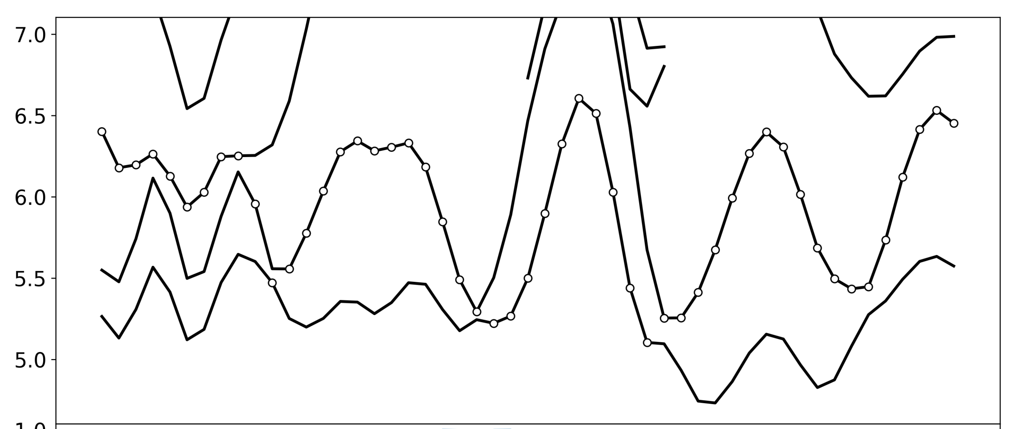
A single trajectory…
$$S_{4}$$
$$B_{2u}(ππ^{∗})$$
$$S_{3}$$
$$A_{u}(nπ^{∗})$$
$$A_{u}(nπ^{∗})$$
$$A_{u}(nπ^{∗})$$
$$B_{3u}(nπ^{∗})$$
$$E (eV)$$
$$S_{2}$$
$$S_{1}$$
$$B_{3u}(nπ^{∗})$$
$$B_{3u}(nπ^{∗})$$
$$Time (fs)$$

Slide 10
Configurationally uniform states
Reference states: $Φ\left(q_{0}\right)=Ψ\left(q_{0}\right)$
Overlap matrix:$S\left(q_{0},q\right)=\left\langle Ψ\left(q_{0}\right) | Ψ\left(q\right)\right\rangle$
Symmetric orthogonalization: $T\left(q\right)=S{(S^{†}S)}^{−1/2}$
Unitary transformation of eigenstates to config. uniform states:
$$Φ\left(q\right)=T\left(q\right)Ψ\left(q\right) H^{\left(Φ\right)}(q)=T(q)H^{(Ψ)}(q)T^{†}(q)$$

Slide 11
A single trajectory…
$$S_{4}$$
$$B_{3u}(nπ^{∗})$$
$$S_{3}$$
$$B_{2g}(nπ^{∗})$$
$$B_{2u}(ππ^{∗})$$
$$E (eV)$$
$$S_{2}$$
$$S_{1}$$
$$A_{u}(nπ^{∗})$$
$$B_{2u}(ππ^{∗})$$
$$B_{3u}(nπ^{∗})$$
Character of $ψ_{λ(t)}$
$$A_{u}(nπ^{∗})$$
$$Time (fs)$$
$$Time (fs)$$

Slide 12
Populations of $Ψ$s and $Φ$s
$$S_{1}$$
$$Π_{n}^{\left(Ψ\right)}\left(t\right)=\frac{1}{N_{traj}}\sum_{i=1}^{N_{traj}}{δ_{n,λ_{i}\left(t\right)}}$$
$$Π_{n}^{\left(Φ\right)}\left(t\right)=\frac{1}{N_{traj}}\sum_{i=1}^{N_{traj}}{{\left|T_{n,λ_{i}\left(t\right)}(t)\right|}^{2}}$$
$$Π_{}^{\left(Ψ\right)}$$
$$S_{2}$$
$$S_{3}$$
$$B_{3u}(nπ^{∗})$$
$$Π_{}^{\left(Φ\right)}$$
$$A_{u}(nπ^{∗})$$
$$B_{2u}(ππ^{∗})$$
$$t (fs)$$
Taken from: T. Horio et al. J. Chem. Phys. 145 (2016) 044306.

Slide 13
Summary
Trajectory Surface Hopping Dynamics:
Classical Nuclear + Quantum Electronic + Nonadiabatic Dynamics
One does not immediatelly see the physically meaningful picture of the simulated process (due to the usage of electronic eigenstates)
Automatized generation of configurationally uniform states along nonadiabatic trajectories

Slide 14
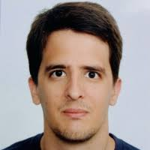
Dr. Nađa Došlić
Dr. Marin Sapunar
Prof. Wolfgang Domcke
Croatian Science Fundation
Research Group Linkage Programme
Thank you for your kind attention!

